Slide 1
Preliminary Genomic Predictions of Feed Saved for 1.4 Million Holsteins

Slide 2
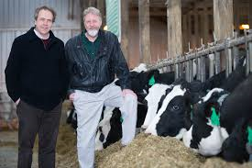
Feed intake data
Research herd | Cows | Records | Researchers
U Wisconsin and US Dairy Forage Research Center | 1390 | 1597 | Weigel, Armentano
Iowa State | 953 | 1006 | Spurlock
USDA-Beltsville, MD | 534 | 834 | Connor
U Florida | 491 | 582 | Staples
Michigan State | 273 | 315 | VandeHaar, Tempelman
Purina An Nutr Center, MO | 151 | 184 | Davidson
Virginia Tech | 93 | 93 | Hanigan
Miner Agr Res Institute, NY | 58 | 58 | Dann
Total | 3947 | 4621 | $5 million AFRI Grant

Slide 3
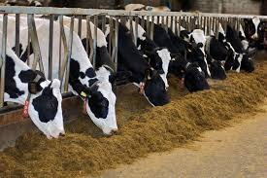
Topics
Residual feed intake (RFI) as a new trait
Data included, models, and parameters
Reliability of predictions
Economic value of feed saved
Reporting of feed intake evaluations

Slide 4
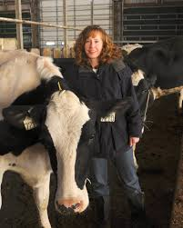
6-week or 4-week trials
 | 6-Week Trials | 4-Week Trials
Days of feed intake | 42 | 28
Cows recorded | 4,621 | 202
RFI mean | 0 | 0
RFI standard deviation (kg/day) | 1.68 | 1.75
Correlation with 6-week trial | 1.00 | 0.96
Weighted in statistical model | 1.00 | 0.92
Approximate cost / cow of recording (+1 week pre-trial) | $700 | $500

Slide 5
Genotypes of research cows
Chip densities (number of markers) used
502 high density (777k)
1341 GHD or GH2 (77k or 140k)
1251 50K or ZMD (50k)
411 low density (7k to 20k)
Imputed to 60,671 subset used officially

Slide 6
National RFI genomic evaluation
RFI from research cows was already adjusted for phenotypic correlations with milk net energy, metabolic body weight, and weight change
Genetic evaluation model: RFI = BreedingValue + PermEnv + HerdxSire + ManagementGroup + Age-Parity + b₁ Inbreeding + b₂ GPTA_{MilkNE} + b₃ GPTA_{BWC}
Remove remaining genetic correlations, include 60 million non-genotyped Holsteins
Genomic model: Predict 1.4 million genotyped Holsteins

Slide 7
Variance estimates for RFI (and SCS)
Parameter | RFI | SCS
Heritability | 14% | 16%
Repeatability | 24% | 35%
Phenotypic correlation with yield | 0.00 | -0.10
Genetic correlation with yield | 0.00 | -0.03
SCS provided a second trait with similar properties, allowing genomic predictions from the research cows to be compared to the national SCS predictions.

Slide 8
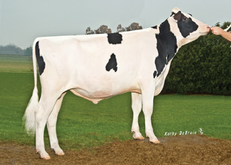
Feed data vs. other trait data
Top 100 proven HO bulls for NM$
Average 739 milk daughters, <0.1 RFI daus
GREL averages 94% milk, 89% NM$, 16% RFI
Top 100 young HO bulls for NM$
GREL averages 75% milk, 71% NM$, 12% RFI
REL_{PA} averages 35% milk, 33% NM$, 3% RFI

Slide 9
Computed vs. actual GREL for SCS
Expected genomic reliability was 19% for both RFI and SCS
SCS GPTAs were correlated by only 0.39 from national vs. research cow reference data
Observed REL of SCS was (0.39)² * 72% = 11%
RFI genomic REL was discounted to agree with Var(PTA) for RFI and observed REL of SCS

Slide 10
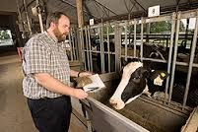
Economic values
Statistic | Milk production (3.5% F, 3.0% P) | Dry matter intake | Residual feed intake
Lactation mean (pounds / lact) | 25,000 | 16,600 | 0
Lactation SD (pounds / lact) | 2,900 | 2,750 | 1,130
Price / pound | $0.17 | $0.12 | $0.12
Mean income or cost / lactation | $4,250 | -$1,992 | 0
Lifetime value / pound (2.8 lactations) | $0.253 | -$0.336 | -$0.336
Relative value (% of net merit) | 36% |  | -16%
● Economic values for milk and body weight continue to subtract the correlated feed consumption.
● Subtraction of expected feed intake from milk yield is the “Net” in Net Merit $.

Slide 11
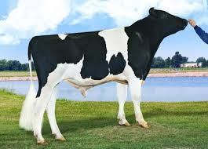
Economic progress
The ratio of progress from the new vs. old index is the square root of:
[REL_{NM} (194²) + REL_{RFI} (70²)] / [REL_{NM} (194²)]
REL_{NM} averages 75% for young bulls and 91% for proven bulls, whereas REL_{RFI} is low (~12% and 16%) due to few records.
Progress for lifetime profit may be only 1.01 times or 1% faster than current NM$ progress

Slide 12
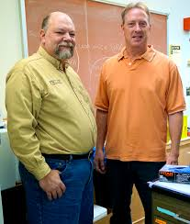
Reporting feed efficiency
Feed efficiency expected from yield & weight
FE$ = (1 – .45) MFP$ – $.31 * 40 * BWC
Current definition used in TPI
New FE$ = FE$ – $.12 * 2.8 lacts * 305 * RFI lb/d
Feed saved (used in AUS , also researcher proposal)
FS lb/lactation = – 305 * RFI lb/d – .20 * 40 *BWC
FS$/lifetime = –$.12 * 2.8 lacts * FS lb/lactation

Slide 13
Conclusions
Feed is the largest single expense of dairies
Producers and researchers have always wanted to measure and select for feed efficiency
Residual feed intake could get ~16% of relative emphasis in net merit, but low REL of ~12% for young animals will limit progress
Genomics can multiply information from a few herds to thousands of other herds

Slide 14
Acknowledgments
Agriculture and Food Research Initiative Competitive Grant #2011-68004-30340 from the USDA National Institute of Food and Agriculture
USDA-ARS project 1265-31000-101-00, “Improving Genetic Predictions in Dairy Animals Using Phenotypic and Genomic Information.”
Council on Dairy Cattle Breeding for data
George Wiggans for managing genotypes
Last research project of Jan Wright 1958-2017

Slide 15
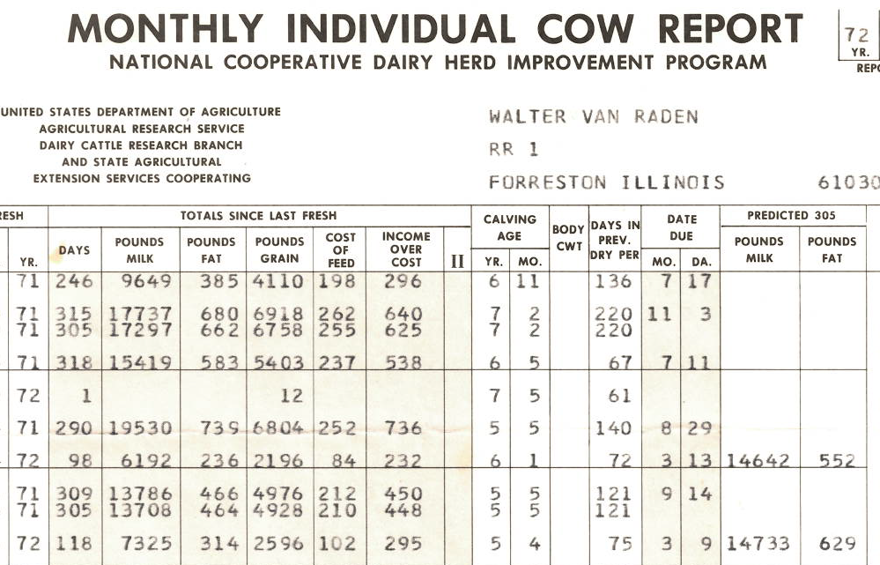
VanRaden DHI feed costs, 1972

Slide 16
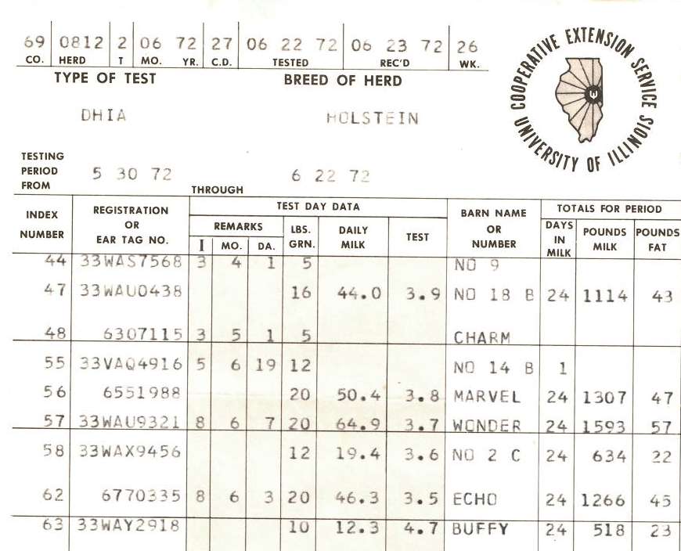
Paul’s DHI feed intake records, 1972

Slide 17
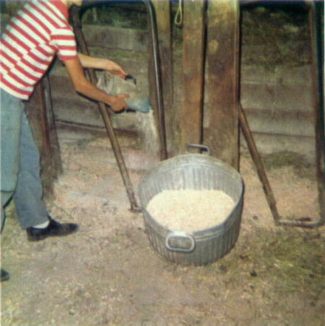
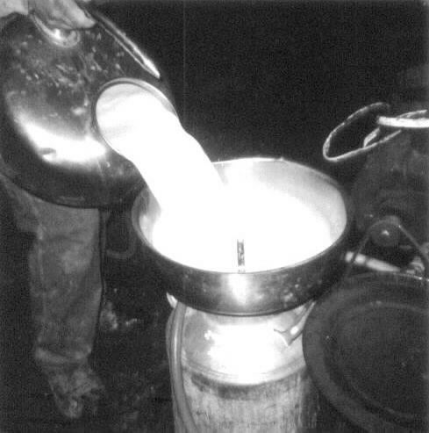
Paul feeding cows, 1974

Slide 18
Early feed intake studies at Beltsville
Hooven et al., 1968 J. Dairy Sci. 51:1409–1419
661 lactations of 318 Holstein cows
Genetic corr (feed efficiency, milk energy) = 0.92
Hooven et al., 1972 J. Dairy Sci. 55:1113–1122
10-month intake trials for 425 cows
30-day trial (month 5) gave 89% of progress

