Slide 1
Validation of genomic predictions and genomic reliability
Mel Tooker and Paul VanRaden
USDA, Agricultural Research Service, Animal Genomics and Improvement Laboratory, Beltsville, MD, USA
melvin.tooker@ars.usda.gov

Slide 2
Topics
Interbull validation of genomic predictions (GPTAs)
Predict later deregressed GPTA from earlier GPTA, weighted by later genomic reliability (GREL)
Simpler validation of GPTA
Predict later GPTA from earlier GPTA
Simple validation of GREL
Estimate earlier GREL from later GREL, genetic standard deviation (SD), and SD of change (later GPTA – earlier GPTA)
Gains in reliability (REL) from more frequent updates

Slide 3
Interbull
International Bull Evaluation Service (Uppsala, Sweden)
Permanent subcommittee of the International Committee for Animal Recording (ICAR)
Responsible for:
Documenting evaluation systems
Forming technical workgroups
Multiple-trait, across-country evaluation (MACE)
Selling domestic semen in many other countries requires that methods used to calculate PTA and GPTA are validated by Interbull every 2 years
Notes:
ICAR - world-wide organization for the standardization of animal recording and productivity evaluations
19 million units of semen were exported in 2016 worth about 143 million dollars (NAAB)

Slide 4
Trend validation – ideal net merit (NM$)

Slide 5
Trend validation – NM$ for proven bulls

Slide 6
Trend validation – NM$ for all bulls

Slide 7
Holstein GPTA validation (preliminary)
Trait | Slope* | Intercept*
Milk | 0.98 | –113
Fat | 0.92 | –2.4
Protein | 0.88 | –1.7
Somatic cell score | 1.06 | 0.3
Daughter pregnancy rate | 1.04 | 0.1
Heifer conception rate | 1.04 | –0.3
Final score | 1.03 | –0.2
Strength | 1.03 | 0.1
*After base change adjustment

Slide 8
Simple GPTA validation results
3,984 young Holstein bulls from Aug. 2014 with >100 daughters in Aug. 2017
Trait | R² (%) | Intercept* | Slope*
Net merit | 82 | –12 | 1.00
Milk | 81 | –131 | 1.01
Fat | 81 | –3 | 0.95
Protein | 80 | –3 | 0.94
Productive life | 83 | –0.3 | 1.07
Somatic cell score | 77 | –0.04 | 1.01
Daughter pregnancy rate | 79 | 0.1 | 1.06
Cow conception rate | 79 | 0.4 | 1.08
Heifer conception rate | 68 | 0.4 | 0.97
*After base change adjustment

Slide 9
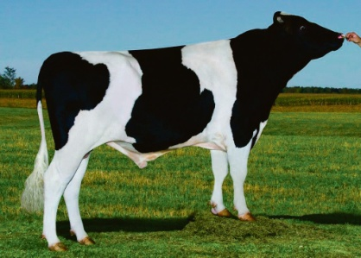
Top proven Holstein bulls (August 2014)
Now with >1,000 daughters
 | NM$ |  |  |  | Progeny (2017)
Bull | 2017 | 2014* | PA 2014* |  | Daughters |  | AI sons
Robust | 744 | 615 | 339 |  | 2,319 |  | 102
Erdman | 704 | 593 | 304 |  | 5,433 |  | 10
Twist | 551 | 567 | 249 |  | 2,302 |  | 4
AltaGreatest | 644 | 555 | 304 |  | 1,365 |  | 10
AltaFairway | 571 | 550 | 376 |  | 2,460 |  | 0
Diesel | 457 | 522 | 302 |  | 1,242 |  | 0
Yano | 466 | 518 | 328 |  | 11,074 |  | 14
Facebook | 440 | 504 | 320 |  | 5,766 |  | 14
Awesome | 492 | 504 | 322 |  | 7,334 |  | 0
Manifold | 558 | 501 | 260 |  | 58,030 |  | 3
Top 10 average | 563 | 543 | 311 |  | 9,733 |  | 16
*Base-adjusted values

Slide 10
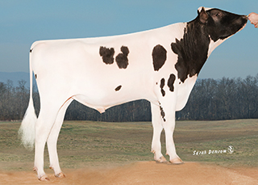
Top young Holstein bulls (August 2014)
Now with >1,000 daughters
 | NM$ |  |  |  | Progeny (2017)
Bull | 2017 | 2014* | PA 2014* |  | Daughters |  | AI sons
Troy | 635 | 747 | 494 |  | 1,209 |  | 58
Rogers | 688 | 708 | 533 |  | 1,338 |  | 17
Cabriolet | 866 | 680 | 507 |  | 6,354 |  | 10
Ponder | 726 | 660 | 533 |  | 1,295 |  | 6
Emerald | 512 | 656 | 500 |  | 1,198 |  | 6
Bombero | 693 | 648 | 538 |  | 1,245 |  | 35
Halogen | 323 | 642 | 475 |  | 1,922 |  | 83
Jayden | 626 | 642 | 464 |  | 2,927 |  | 3
Supersire | 855 | 642 | 510 |  | 16,627 |  | 260
Donatello | 755 | 639 | 561 |  | 4,743 |  | 18
Top 10 average | 668 | 666 | 511 |  | 3,886 |  | 50
*Base-adjusted values

Slide 11
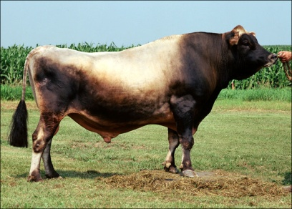
Top proven Jersey bulls (August 2014)
Now with >100 daughters
 | NM$ |  |  |  | Progeny (2017)
Bull | 2017 | 2014* | PA 2014* |  | Daughters |  | AI sons
Volcano | 433 | 515 | 313 |  | 4,167 |  | 29
Magnum | 501 | 497 | 218 |  | 5,985 |  | 10
Link | 427 | 450 | 213 |  | 1,760 |  | 3
Daybreak | 510 | 410 | 281 |  | 935 |  | 5
Hickey | 429 | 405 | 292 |  | 266 |  | 4
Bindy | 395 | 404 | 153 |  | 619 |  | 0
Arhil | 346 | 402 | 149 |  | 106 |  | 0
Zimpel | 408 | 396 | 190 |  | 100 |  | 0
Victory | 351 | 385 | 295 |  | 1,522 |  | 2
Memo | 158 | 383 | –64 |  | 243 |  | 0
Top 10 average | 396 | 425 | 204 |  | 1,570 |  | 5
*Base-adjusted values

Slide 12
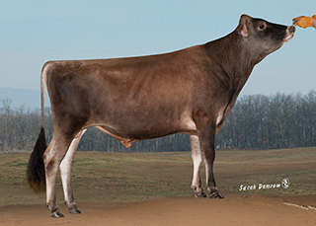
Top young Jersey bulls (August 2014)
Now with >100 daughters
 | NM$ |  |  |  | Progeny (2017)
Bull | 2017 | 2014* | PA 2014* |  | Daughters |  | AI sons
Harris | 654 | 567 | 386 |  | 2,113 |  | 59
Mackenzie | 525 | 536 | 313 |  | 383 |  | 8
Machete | 421 | 535 | 379 |  | 2,283 |  | 8
Formidable | 424 | 530 | 405 |  | 642 |  | 6
Hector | 393 | 528 | 376 |  | 138 |  | 1
Walter | 561 | 522 | 389 |  | 289 |  | 3
Revolution | 457 | 516 | 347 |  | 215 |  | 2
Marlo | 684 | 508 | 420 |  | 407 |  | 19
Pilgrim | 559 | 486 | 298 |  | 600 |  | 4
Chili | 514 | 486 | 335 |  | 984 |  | 17
Top 10 average | 519 | 522 | 365 |  | 805 |  | 13
*Base-adjusted values

Slide 13
Data for validating GREL
Published GPTAs
April 2014 (GREL₂₀₁₄)
April 2017 (GREL₂₀₁₇)
SD of difference in GPTAs
REML estimates of SD of true transmitting ability (TA) from Interbull MACE

Slide 14
Example GREL validation (Holstein protein)
Average published GREL₂₀₁₄ was 0.76
GREL₂₀₁₇ was 0.95
SD of change was 8.4
REML TA SD was 17.5
Observed GREL₂₀₁₄ for protein calculated as:
GREL₂₀₁₄= 0.95 – 8.4²/17.5²
= 0.72

Slide 15
Observed vs. published GREL (2014)
 | Jersey |  |  |  | Holstein
Trait* | Obs | Pub | Diff |  | Obs | Pub | Diff
Milk | 73 | 68 | +5 |  | 72 | 76 | –4
Fat | 72 | 68 | +4 |  | 74 | 76 | –2
Protein | 71 | 68 | +3 |  | 72 | 76 | –4
PL | 47 | 55 | -8 |  | 65 | 70 | –5
SCS | 64 | 62 | +2 |  | 77 | 73 | +4
DPR | 63 | 52 | +11 |  | 69 | 68 | +1
NM$ | 68 | 64 | +4 |  | 68 | 73 | –5
Average | 65 | 62 | +3 |  | 71 | 73 | –2
*PL = productive life; SCS = somatic cell score;
DPR = daughter pregnancy rate

Slide 16
Average REL for NM$ by age

Slide 17
Phenotypic update frequency
Suppose REL increases steadily from REL₁ to REL₂ across a year
Gain in REL from n updates per year (REL_{n}) instead of 1 annual update should average:
Example: Suppose average bull REL increases from 75% (REL₁) to 91% (REL₂) when 4 years old (no daughters → many daughters)
Minimum gain is 0% with an annual update because bulls would stay at 75% for the whole year
Maximum gain is 8% with instant updating; bulls would average (75 + 91)/2 = 83% during that year

Slide 18
Phenotypic update frequency (continued)

Slide 19
REL gains by update frequency
Frequency | Updates | Young |  |  |  | Proven
 |  | REL (%) |  | Marginal gain |  | REL (%) |  | Marginal gain
Annual | 1 | 73.10 |  | 0.00 |  | 75.00 |  | 0.00
6 months | 2 | 73.70 |  | 0.60 |  | 79.00 |  | 4.00
4 months | 3 | 73.90 |  | 0.20 |  | 80.30 |  | 1.30
3 months | 4 | 74.00 |  | 0.10 |  | 81.00 |  | 0.70
2 months | 6 | 74.10 |  | 0.10 |  | 81.60 |  | 0.60
Monthly | 12 | 74.20 |  | 0.10 |  | 82.30 |  | 0.70
Weekly | 52 | 74.28 |  | 0.08 |  | 82.80 |  | 0.50
Daily | 365 | 74.29 |  | 0.01 |  | 82.97 |  | 0.17
Instant | ∞ | 74.30 |  | 0.01 |  | 83.00 |  | 0.03

Slide 20
Conclusions
Simpler validation of GPTA is easier to compute and explain, but not quite as independent
New procedure developed to validate GREL
GPTA properties are very close to expected
GRELs were slightly too high (2%) for Holsteins, slightly too low (3%) for Jerseys
Recent GPTAs (young and old) may all be too low (genetic trend is underestimated)
Genetic progress is fast!

Slide 21
Acknowledgements
Interbull Working Group on Genomic Reliability (Zengting Liu, Paul VanRaden, Martin Lidauer, Mario Calus, Vincent Ducrocq, Haifa Benhajali, and Hossein Jorjani)
Council on Dairy Cattle Breeding for DHI data from dairy farmers
USDA-ARS project 1265-31000-101-00, “Improving Genetic Predictions in Dairy Animals Using Phenotypic and Genomic Information”

